Slide 1

Performance Optimization for Desktop Cloud Apps
Alex Riofrio, DORA Sistemas
December, 2025

Slide 2
Presenter Profile
Recent Projects
2019 – Present: Product Manager (Appeon Latam) | Course Creator | Instructor.
  Moving to PowerBuilder 2025
  Moving to PowerBuilder 2022 R3
  Building Desktop-to-Cloud Solutions with PowerBuilder and SnapDevelop 2022 R3
2005 – Sybase PowerBuilder Certified.
Alex Riofrio
Key Skills
linkedin.com/in/alex-riofrio
PowerBuilder
PowerServer
.NET DataStore
Node.js

Slide 3

Company Profile
DORA SISTEMAS
Appeon Master Distributor in LATAM.
Offices in Mexico, Peru and Colombia.
Technical Support in Spanish for Latin America,
PowerBuilder, PowerServer and SnapDevelop courses.
Software Outsourcing.

Slide 4
DISCLAIMER
This presentation was authored by volunteer(s) in the Appeon community. This is not a work for hire by Appeon. The views and opinions expressed in this presentation are those of the author(s).
Its contents are protected by US copyright law and may not be reproduced, distributed, transmitted, displayed, published or broadcast without the prior written permission of Appeon. All rights belong to their respective owners.
Any reference to third-party materials, including but not limited to Websites, content, services, or software, has not been reviewed or endorsed by Appeon. YOUR USE OF THIRD-PARTY MATERIALS SHALL BE AT YOUR OWN RISK.
Appeon makes no warranty of any kind, either express or implied, including but not limited to, the implied warranties of merchantability, fitness for a particular purpose, or non-infringement. Appeon assumes no responsibility for errors or omissions.

Slide 5
Session Agenda
Key Variables Affecting PowerBuilder Apps Performance
  C/S, PowerServer
Strategies for Rock-Solid Cloud App Performance on the Internet
      Latency and Bandwidth
      Recursive SQL
      Data Volume
Q&A Time

Slide 6
Session
Agenda
Key Variables Affecting PowerBuilder Apps Performance
Strategies for Rock-Solid Cloud App Performance on the Internet
Q&A Time

Slide 7

Key Variables Affecting PowerBuilder Apps Performance
General
PowerBuilder App | Local Computing | Recursive SQL | SQL/Data-Intensive | Network
C/S (LAN)
PowerServer (WAN/Internet)
Network chatter and network-intensive code

Slide 8
Key Variables Affecting PowerBuilder Apps Performance
Network
Latency: is the time a data packet takes to travel across the network from its source to its destination.
  Measured in milliseconds (ms).
  It represents delay.
Bandwidth: is the maximum rate at which data can be transmitted over a network connection within a given time period.
  Measured in bits per second (bps, Mbps, Gbps).
  It represents capacity or throughput.

Slide 9


Key Variables Affecting PowerBuilder Apps Performance
Network
Network | Latency | Bandwith
LAN | 1 ms | 1-10 Gbps
WAN/Internet | 20-100 ms | 20-125 Mbps
RATIO WAN/LAN | 20 to 100 higher | 8 to 80 lower

Slide 10
Session
Agenda
Key Variables Affecting PowerBuilder Apps Performance
Strategies for Rock-Solid Cloud App Performance on the Internet
Q&A Time

Slide 11
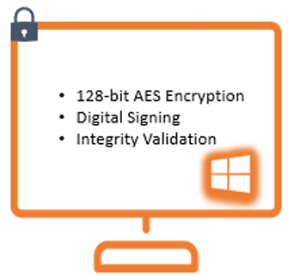
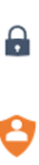
Strategies for Rock-Solid Cloud App Performance on the Internet
1. Latency and Bandwidth
REST Interface
Local Computing
WAN/Internet
PowerServer API
HTTP(S)
ESQL & DW Models
Embedded SQL
Stored procedures / DB functions
DataWindow/DataStore functions
Transaction functions (SyntaxFromSQL)
Calling a Web Service
.NET 8
PB App
Recursive/
Intensive SQL??
PowerServer
LAN
TCP/IP
Database

Slide 12
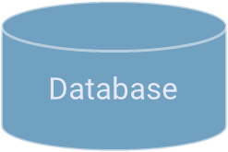
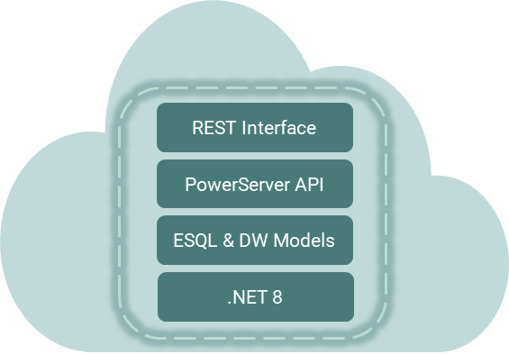
Strategies for Rock-Solid Cloud App Performance on the Internet
2. Recursive SQL
Recursive server calls can be risky, as they may quickly generate a large volume of requests (network chatter), degrading overall performance.
LAN
C/S
Workload | Latency | Time
10-loop | 1 ms | 10 ms
WAN/Internet
LAN
Cloud
App
Workload | Latency 1 | Latency 2 | Time
10-loop | 50 ms | 1 ms | 510 ms

Slide 13
Strategies for Rock-Solid Cloud App Performance on the Internet
2. Recursive SQL
To ensure your PowerBuilder applications perform well in a cloud environment. At a high-level, your code needs to be written such that the server calls is minimized or relocated to the middle-tier or back-end:
  Embedded SQLs.
  DW Computed fields calling PowerScript with ESQL.
  Merging / Sending multiple requests in one call with PowerServerLabel.

Slide 14
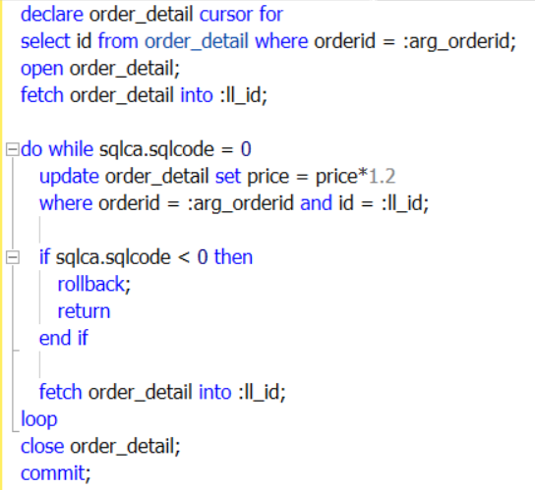
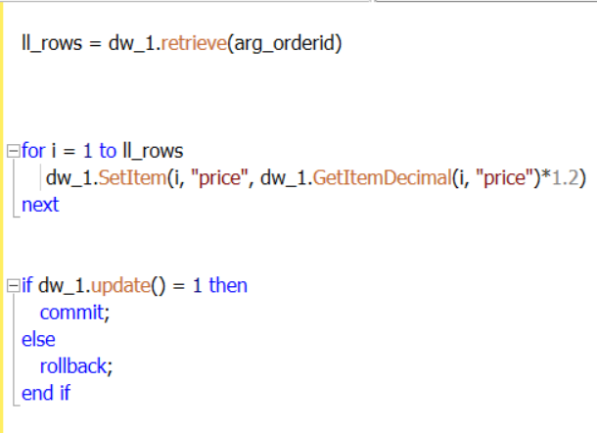
Strategies for Rock-Solid Cloud App Performance on the Internet
2.1. Recursive SQL: Embedded SQLs
PScript Original
Workaround

Slide 15
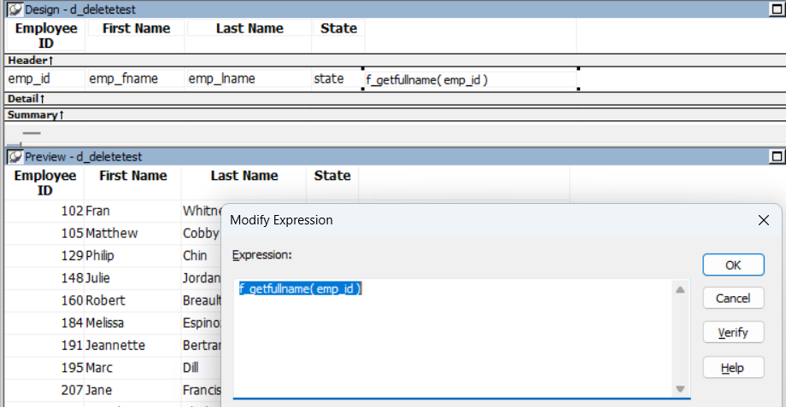
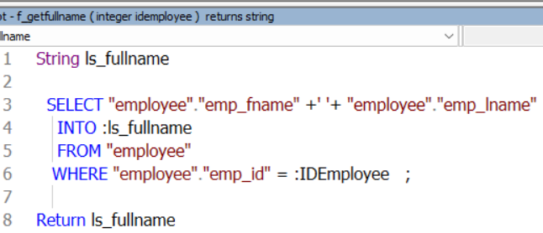
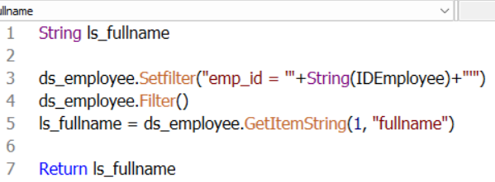
Strategies for Rock-Solid Cloud App Performance on the Internet
2.2. Recursive SQL: DW Computed fields calling PowerScript with ESQL
Original
Workaround
Change the DataWindow SQL to join related tables to get data directly.
Retrieve all required data to a DataStore and modify the user function to get data from the DataStore instead of from the database.

Slide 16
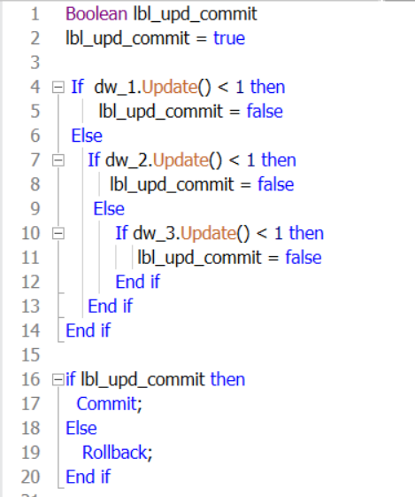
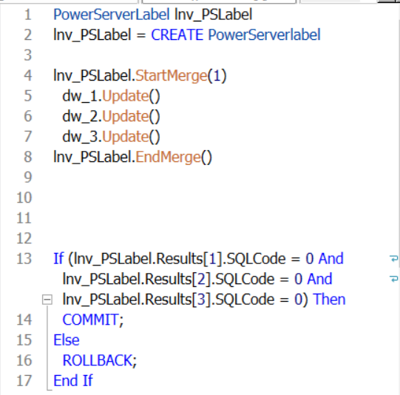
Strategies for rock-solid Cloud App performance on the Internet
2.3. Recursive SQL: Merging/Send multiple requests in one call with PowerServerLabel
Original
Workaround

Slide 17
Demo:

Slide 18
Strategies for Rock-Solid Cloud App Performance on the Internet
3. Data Volume
Once you are certain the slow-down is not caused by excessive server calls then you can consider reducing the size of data transmission:
  Retrieve data gradually to reduce load and improve responsiveness.
  Select only the necessary columns to optimize queries.
  Configuring request header for large data.

Slide 19
Strategies for Rock-Solid Cloud App Performance on the Internet
3.1. Data Volume: Retrieve data gradually
Since the “Retrieve As Needed” and “Rows to Disk” options are not supported in PowerServer apps, you can use the following options to further filter the data at the source.
  Add a WHERE clause to retrieve only the data needed.
  Use a NEXT button to the DW and modify the SQL query to support pagination (ROWNUM / TOP).
  Page records from a Web API:
      .NET DataStore API (RetrieveByPage)
      SnapObjects (SqlQueryBuilder/Page).

Slide 20
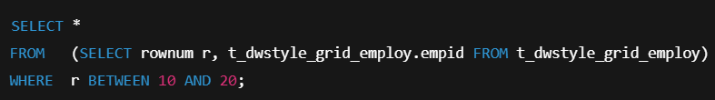
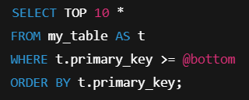
Strategies for Rock-Solid Cloud App Performance on the Internet
3.1.b. Data Volume: Retrieve data gradually (NEXT Button)
Using a NEXT button to the DW and modify the SQL query to support pagination (ROWNUM / TOP).
Oracle:
Non-Oracle
database:

Slide 21
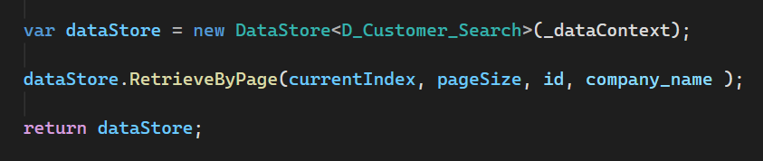
Strategies for Rock-Solid Cloud App Performance on the Internet
3.1.c.i. Data Volume: Retrieve data gradually - Page records from a Web API
Using .NET DataStore API (RetrieveByPage).

Slide 22
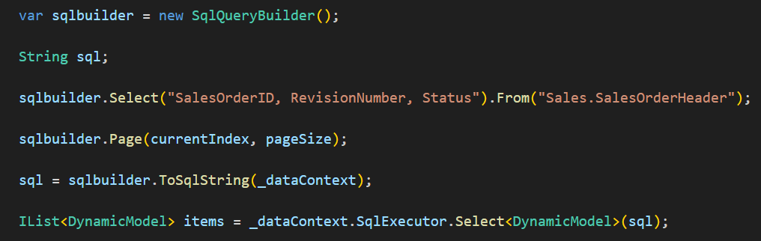
Strategies for Rock-Solid Cloud App Performance on the Internet
3.1.c.ii. Data Volume: Retrieve data gradually - Page records from a Web API
Using SnapObjects (SqlQueryBuilder/Page).

Slide 23
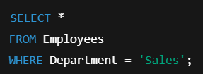
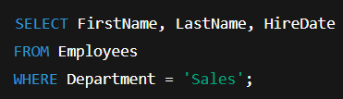
Strategies for Rock-Solid Cloud App Performance on the Internet
3.2. Data Volume: Select only the necessary columns
As the number of rows in the result set increases, the number of columns will cause greater degradation in performance, especially for nested loops in your application which process rows in the outer loop, and columns in the inner loop.
A sign of unintentionally excessive columns would be the SQL syntax Select * From.

Slide 24
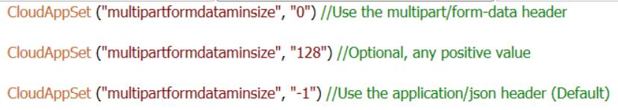
Strategies for Rock-Solid Cloud App Performance on the Internet
3.3. Data Volume: Configuring request header for large data
You can specify the HTTP request header (multipart/form-data) to send large structured data, blobs, or files or a combination of them in a single request.
When multipart/form-data is used, data will be compressed when sending from the client PC to PowerServer.

Slide 25
Demo:

Slide 26
Thank you

Slide 27







Connect with Us
community.appeon.com
Discussions, tech articles and videos, free online training, and more.
facebook.com/AppeonPB
x.com/AppeonPB
Encourage us with a “like”, see cool pics, and get notified of upcoming events.
Follow Appeon and community members to get the latest tech news.
linkedin.com/company/appeon
youtube.com/Appeon
Build up your career profile, and stay in contact with other professionals.
Share important Appeon videos with others; no account registration required.

Slide 28
Session Agenda
Key Variables Affecting PowerBuilder Apps Performance
Strategies for Rock-Solid Cloud App Performance on the Internet
Q&A Time

Slide 29
Q&A Time
Q
A
&

